Slide 1




EXCELR
Raising Excellence
Analysis of Flight Delays

Slide 2
Team Members
CLIVE ANDREWS
MENTORS
SHAILGIRI JAISWAL
ANUSHA VEERASAMY
SHUBHAM
SRUSHTI KURDIKERI
VAISHNAVI JUNJARWAD
THANUJA K M
REKHA GURAVVAGOL
PRASHANTH MUNDE

Slide 3
Agenda
PROJECT INTRODUCTION
KPI'S OVERVIEW
EXCEL DASHBOARD
MYSQL DASHBOARD
TABLEAU DASHBOARD
POWERBI DASHBOARD
CONCLUSION
CHALLENGES FACED

Slide 4
Project Introduction
This project is the "Analysis of Flight Delays“ in the Aviation Domain.
Goal: Provide insight into the reasons for delay and associated vectors to help and improve the
overall performance.
Objective
Comprehensive understanding of Airline Performance, Flight Status
Reasons contributing for Flight delay
Week, State, City-Wise performance of Airlines to help customers choose Airlines.
KPIs Analyzed
Weekday Vs Weekend total flights statistics
Total number of cancelled flights for JetBlue Airways on first date of every month
Week wise, State wise and City wise statistics of delay of flights with airline details
Number of airlines with No departure/arrival delay with distance covered between 2500 and 3000

Slide 5
Contd…
Data Sources: We were provided with 3 datasets as .csv documents.
airlines.csv - 15 rows
airport.csv - 323 rows
flights.csv - 5,819,080 rows
Expected Outcomes:
Creation of Main Dashboard having the 4 KPI’s and Sub-Dashboards for each KPI.
Used Tools : Excel, MySQL, Tableau and Power Bi

Slide 6
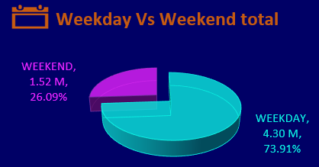
KPI-1
Weekday Vs Weekend total flights statistics
Total count for flights on the Weekday
is much higher than Weekend
Most of the Flights are booked on
Thursday i.e., 873K (approx.)
Least flights are booked on Saturday
i.e., 701K (approx.)

Slide 7
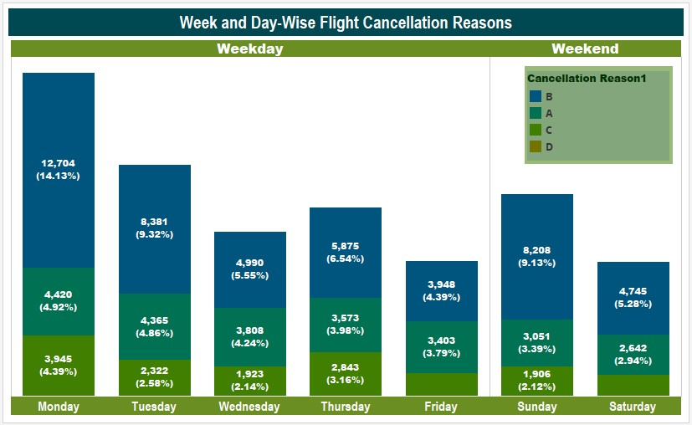
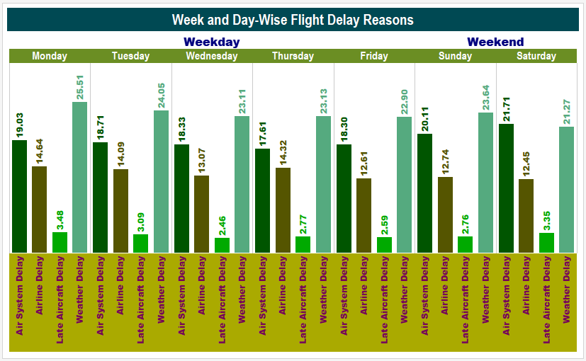
KPI-1 Sub-Dashboard
Weekday Vs Weekend total flights statistics
Month-Wise Total Flights is fairly consistent, with highest in July (520K).
Maximum cancellations on Monday and Tuesday. Major cancellation reason is “B”
Maximum delay on Monday and Tuesday. Major delay reasons being “Weather” and “Air System” except for Saturday

Slide 8
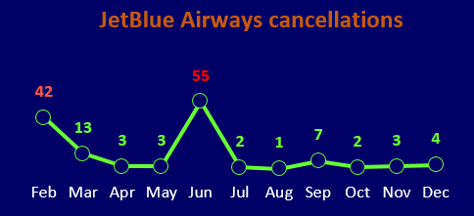
KPI-2
Total number of cancelled flights for JetBlue Airways on first date of every month
Total number of cancelled flights for JetBlue Airways on first date of every month is 135
Maximum cancelled flights on first date of every month-
Least cancelled flights on first date of every month-

Slide 9
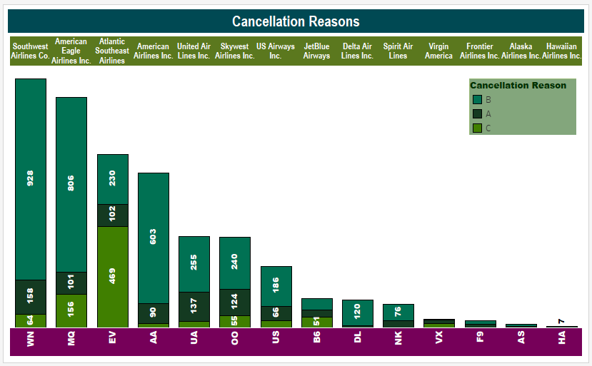
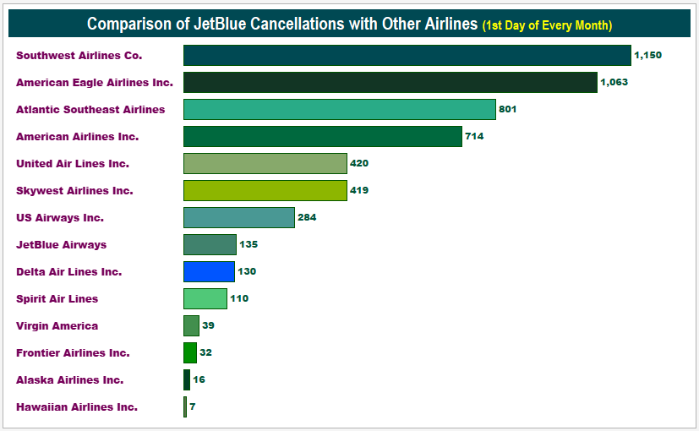
KPI-2 (Sub-Dashboard)
Major Cancellation Reason for Day-1 is “B”
Many Airlines have more cancellations that JetBlue
Delta Airlines has lesser cancellations than JetBlue and is consistent.

Slide 10
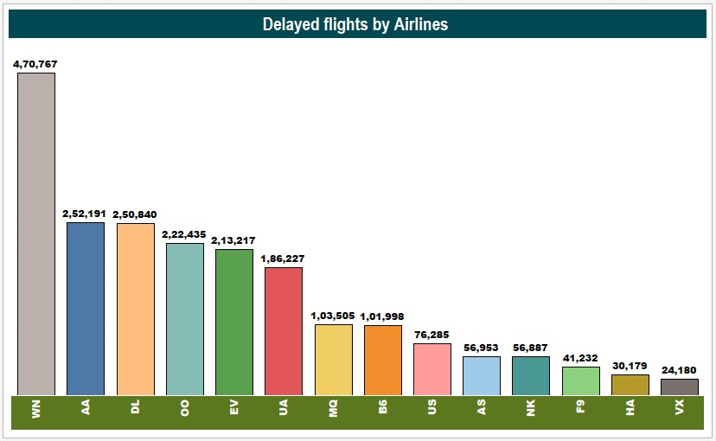
KPI-3
Week wise, State wise and City wise statistics of delay of flights with airline details
We see that the most delay is seen for South West Airlines with 471k
This is followed by :
American Airlines with 252.19 K
Delta Airlines with 250.84 K
Skywest Airlines with 222.44 K

Slide 11
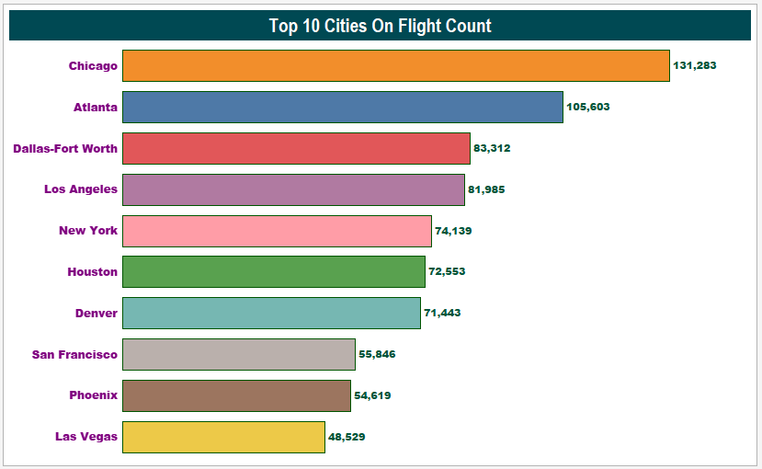
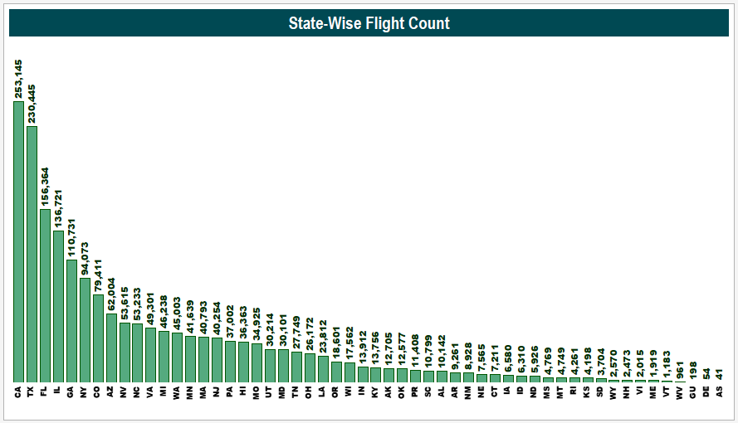
KPI-3 (Sub-Dashboard)
California and Texas are the top States with highest Delayed Flight Count.
Chicago and Atlanta are the top City in Delayed Flight Count.

Slide 12
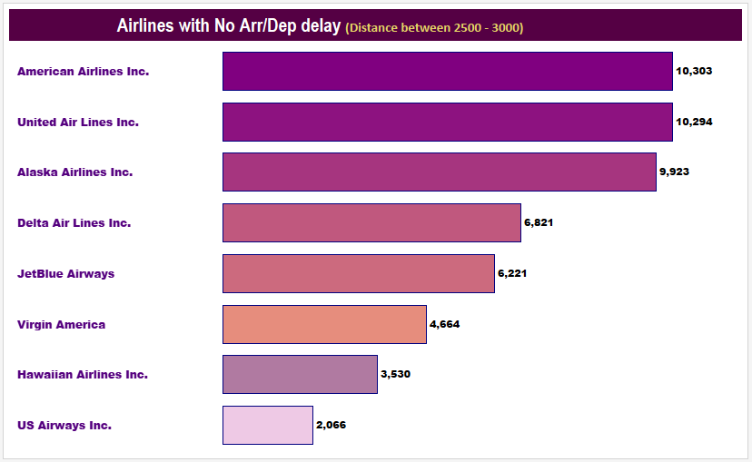
KPI-4
Number of Airlines with No departure/arrival delay with distance covered between 2500 and 3000
There were a total of 53.8K flights with No Departure or Arrival Details
Top 3
American Airlines with 10,303
United Airlines with 10,294
Alaska Airlines with 9923

Slide 13
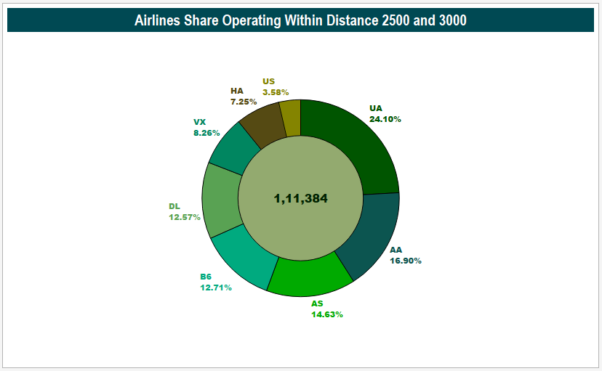
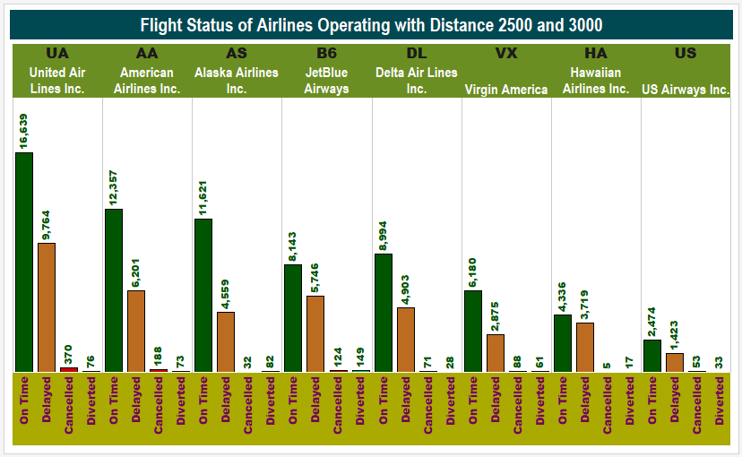
KPI-4 (Sub-Dashboard)
There were a total of 8 Airlines Operating with Distance 2500 - 3000
Top 3 Operators (Market Share)
United Air Lines Inc. with 24%
American Airlines with 16.9%
Alaska Airlines with 14.6%

Slide 14
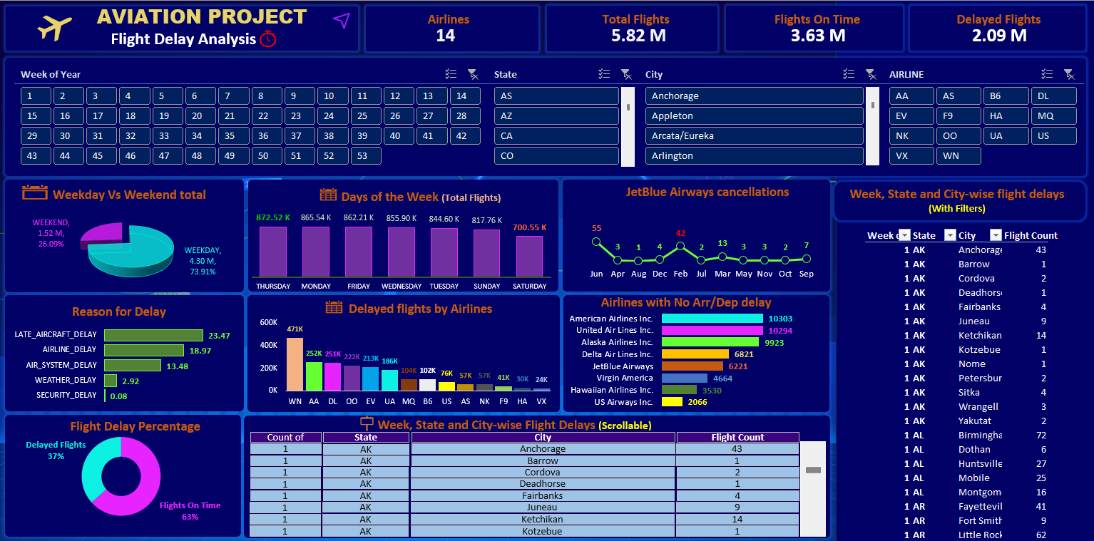
EXCEL Dashboard

Slide 15
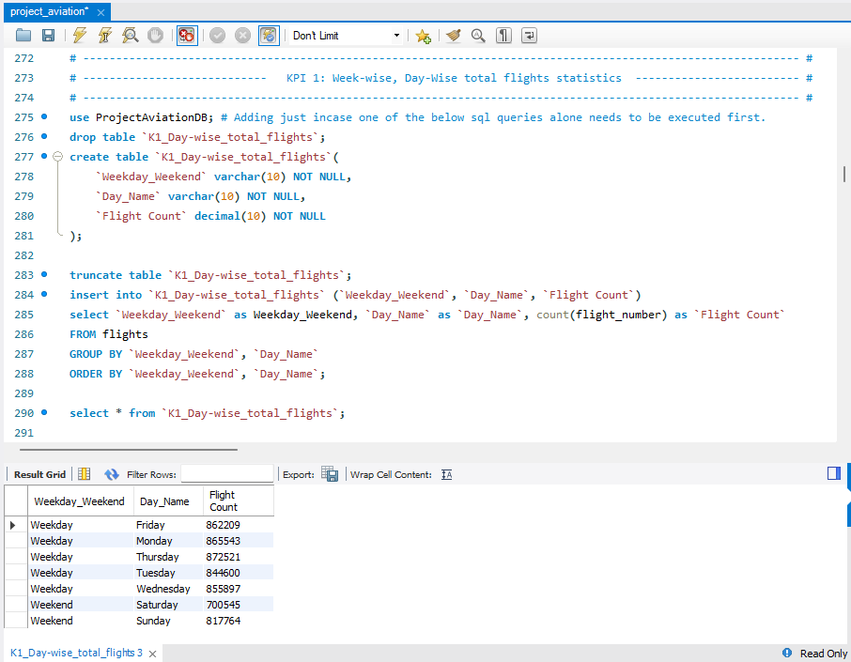
MYSQL Queries (KPI -1)

Slide 16
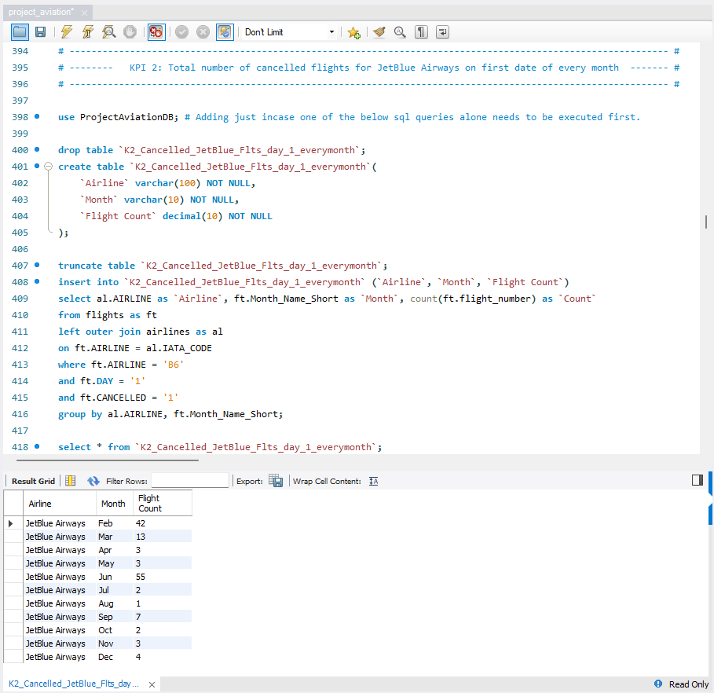
MYSQL Queries (KPI -2)

Slide 17
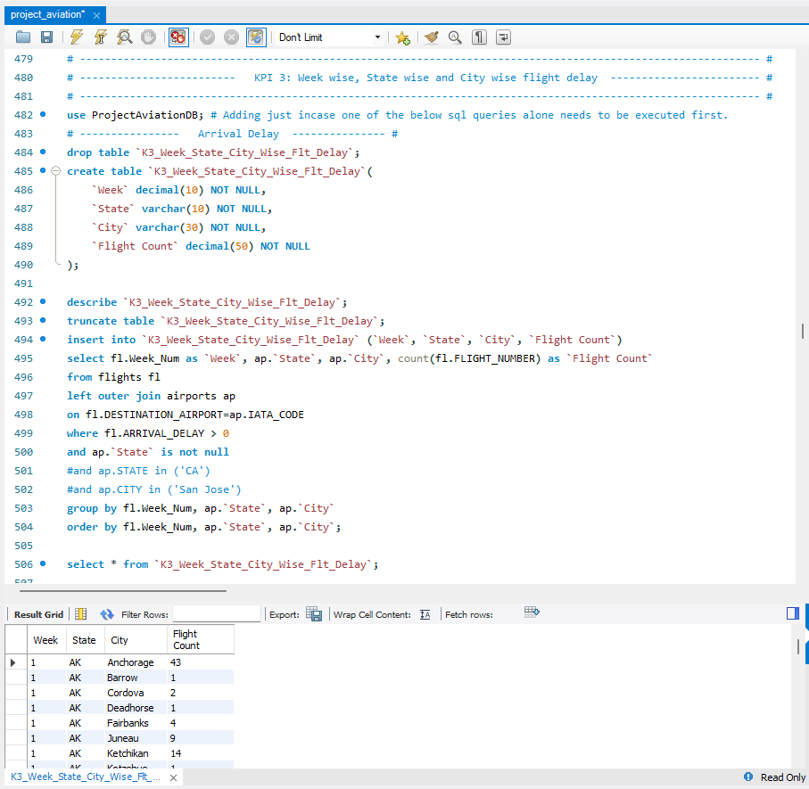
MYSQL Queries (KPI -3)

Slide 18
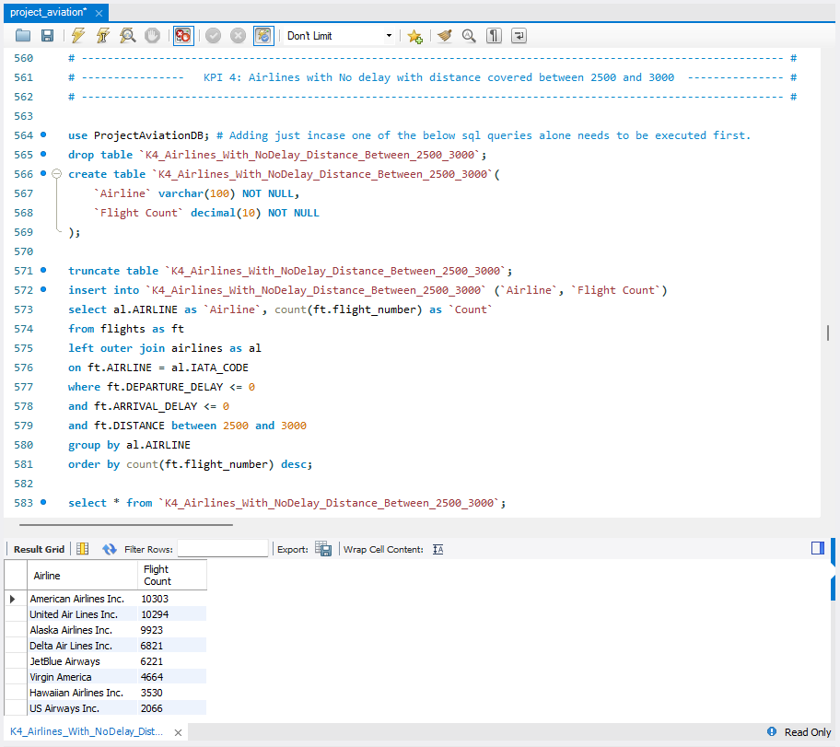
MYSQL Queries (KPI -4)

Slide 19
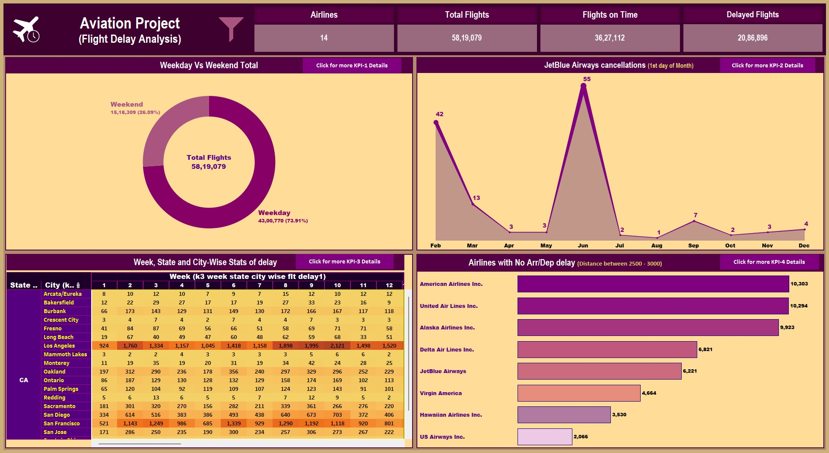
Tableau Main Dashboard

Slide 20
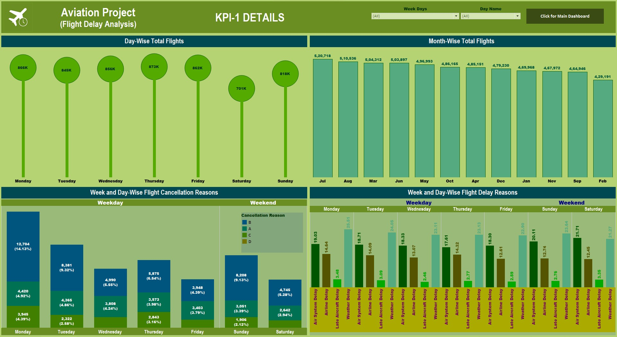
Tableau Sub-Dashboard (KPI-1)

Slide 21
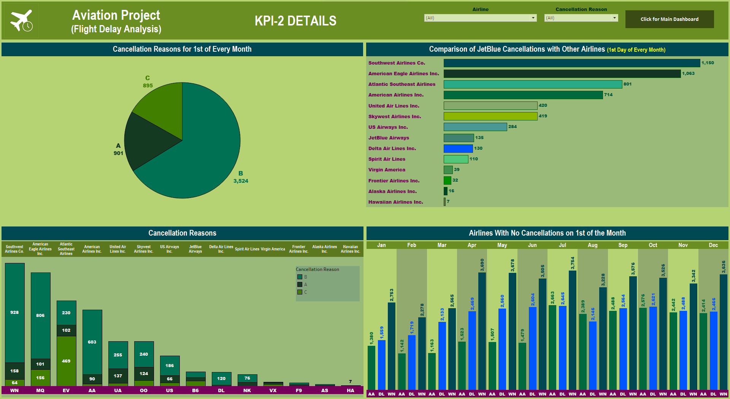
Tableau Sub-Dashboard (KPI-2)

Slide 22
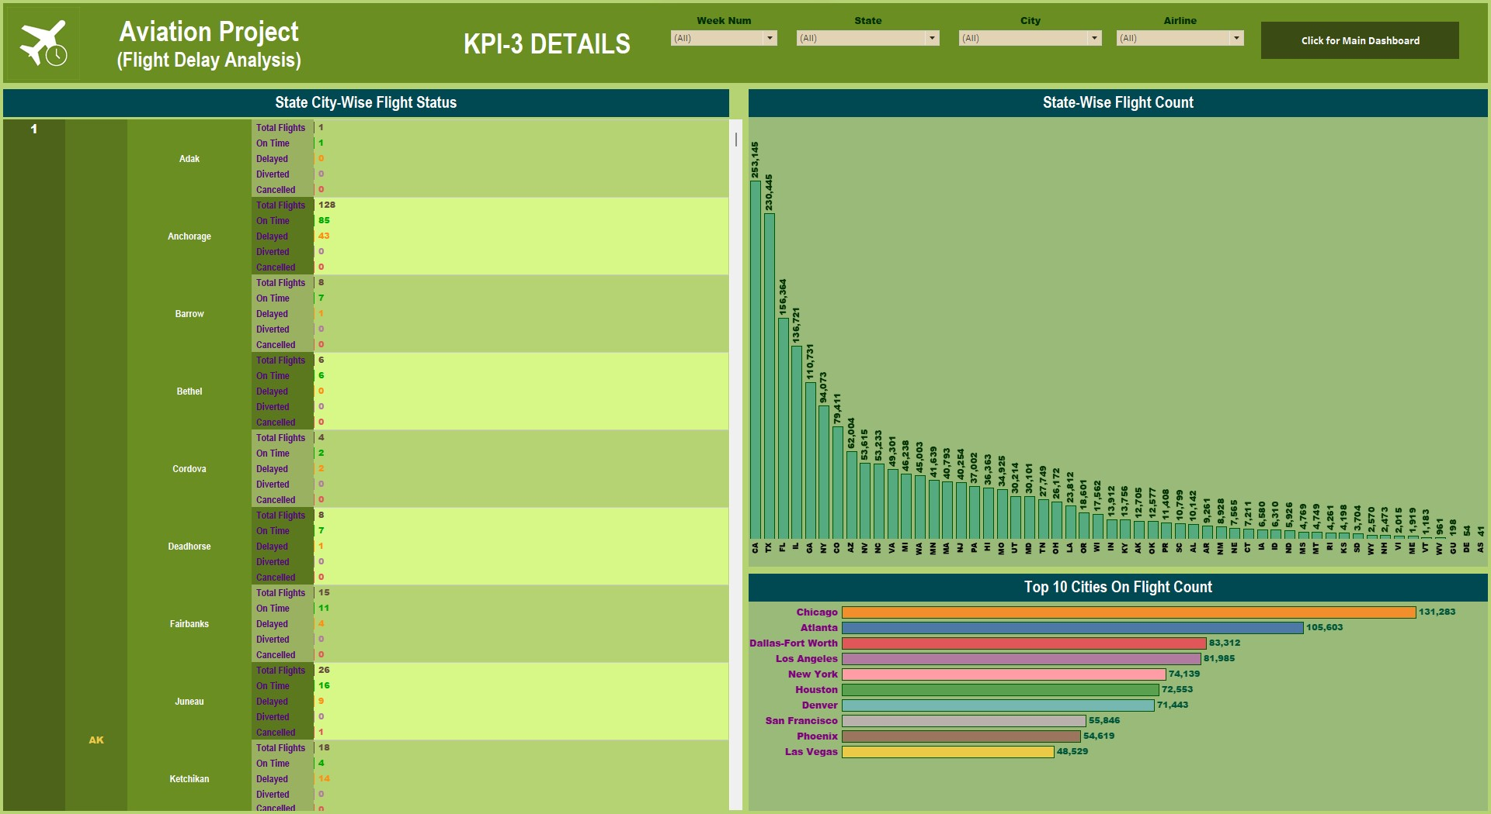
Tableau Sub-Dashboard (KPI-3)

Slide 23
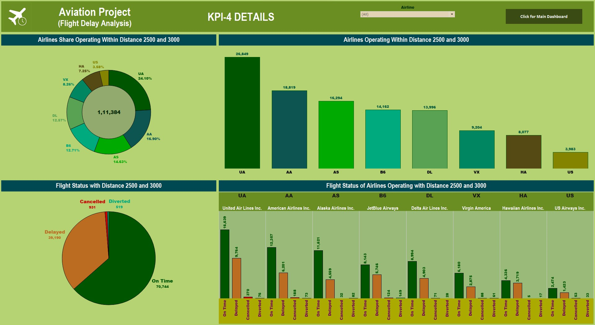
Tableau Sub-Dashboard (KPI-4)

Slide 24
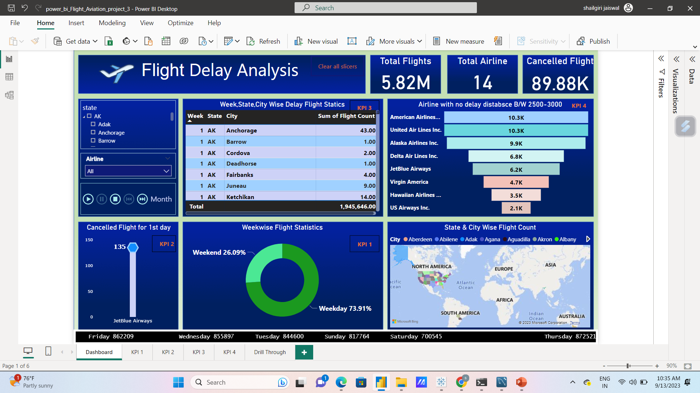
POWER BI Dashboard

Slide 25

CONCLUSION
KEY FINDINGS:
Flight Delay Percentage Chart shows us that the fight Delay is 36% and 62% being on time.
SouthWest Airlines is the Top Most On Time as well as Delayed Flight record
When we checked for the reason for delay –
Late Aircraft Delay – 23 minutes (Avg.)
Airline Delay – 19 minutes (Avg.)
Air System Delay – 13 minutes(Avg.)
Weather – 2.92 minutes(Avg.)

Slide 26
REVIEW
Import data
Clean data
Merged files
Creating relationship and analyzing with different tools
Visualization
Showcasing the same KPI's on different tools
Working within team, helping and motivating each other

Slide 27

CHALLENGES FACED
Importing the large file "flights.csv" having ~5.8Million records into Excel and MySQL.
It was time consuming so used Import command in MySQL
Merging data in Excel in order to get KPI and other information
Faced difficulty while Importing MySQL queries in PowerBI, had to install latest MySQL connectors
Tableau was hanging when creating filters involving large-size queries, esp. KPI-3

Slide 28
THANK YOU

